Slide 1

What are Hooks
React new feature that allow you to use React without write class.

Slide 2
Why Hooks?
This keyword in React different from JS. And with Hooks you don’t need to hard coded.
Hooks helps us to manage State very easy.
In React data fetching and not organized in one place. Hooks solve it in one place.
In Hooks state doesn’t have to be object

Slide 3
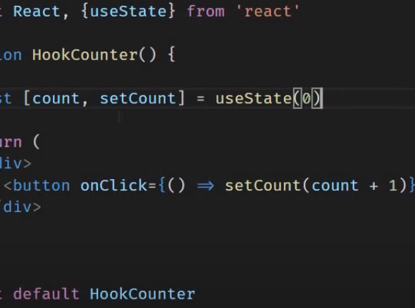
UseState
useState- is the way to initial a var in hooks.
In one line you create a var and a setter for this var.
When you set the value the whole component will render.

Slide 4
Hooks Rules
Write hooks on the Top Level.
Write Hooks from React Functions.

Slide 5
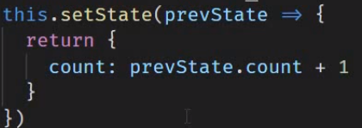
Use State –con.(useState with previous state)
Anytime you need to update state value base prev value. Use callback function.
In class Component:

Slide 6
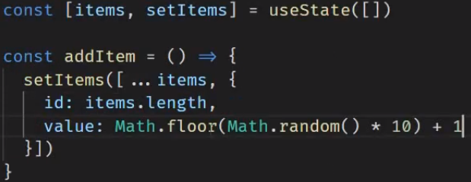
UseState – con. Handle with array and objects

Slide 7
Back to React Component lifecycle methods
componentWillMount() - is done before the INITIAL render of a component, and is used to assess props and do any extra logic based upon them (usually to also update state), and as such can be performed on the server in order to get the first server side rendered markup.
componentDidMount() - is performed AFTER the initial render when the DOM has been updated (but crucially BEFORE this DOM update is painted to the browser, allowing you to do all kinds of advanced interactions with the DOM itself). This of course can only happen in the browser itself and so does not occur as part of SSR, as the server can only generate markup and not the DOM itself, this is done after it gets sent to the browser if using SSR.
componentDidUpdate() - componentDidUpdate() is invoked immediately every time the updating occurs. This method is not called for the initial render.
componentWilUnmout() - this method call before component destroyed

Slide 8
Methods prefixed with will are called right before something happens and
Methods prefixed with did are called right after something happens.

Slide 9


useEffect
It’s a methods that runs after every render and in the initial render.
The second parameter is an option.
[] – empty array – just for initial render only.
[var] – any variable – if modified rerender.
Empty – render each time we use usestate.

Slide 10

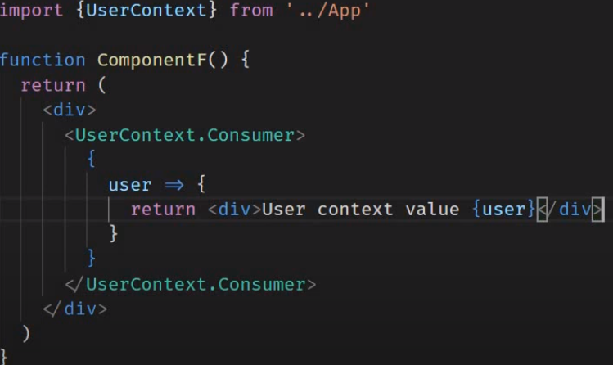
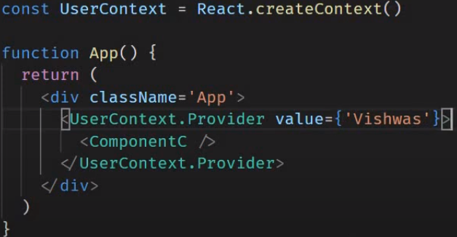
React ContextAPI
Context provide a way to pass data through the component tree without having to pass props down manually at every level.

Slide 11
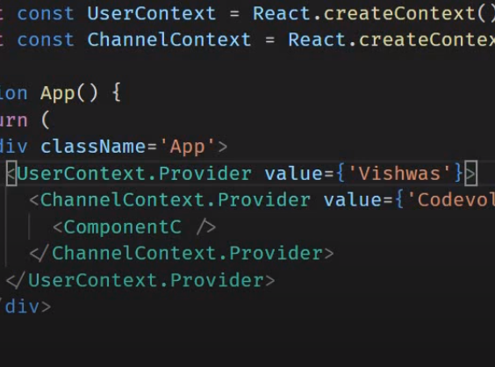
useContext
the first steps are the same like React Context.(CreateContext and Provider)

Slide 12
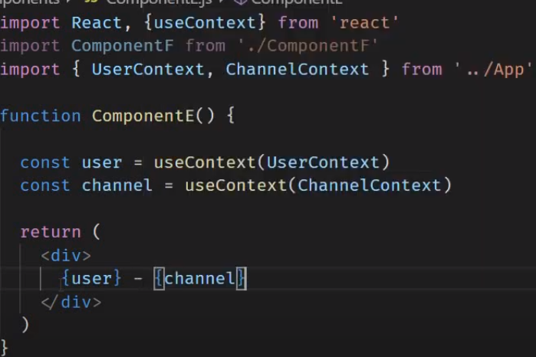
useContext – con.

Slide 13
useRuducer
useRuducer is a hook that is used for state management in React.
It is an alternative to useState.

Slide 14

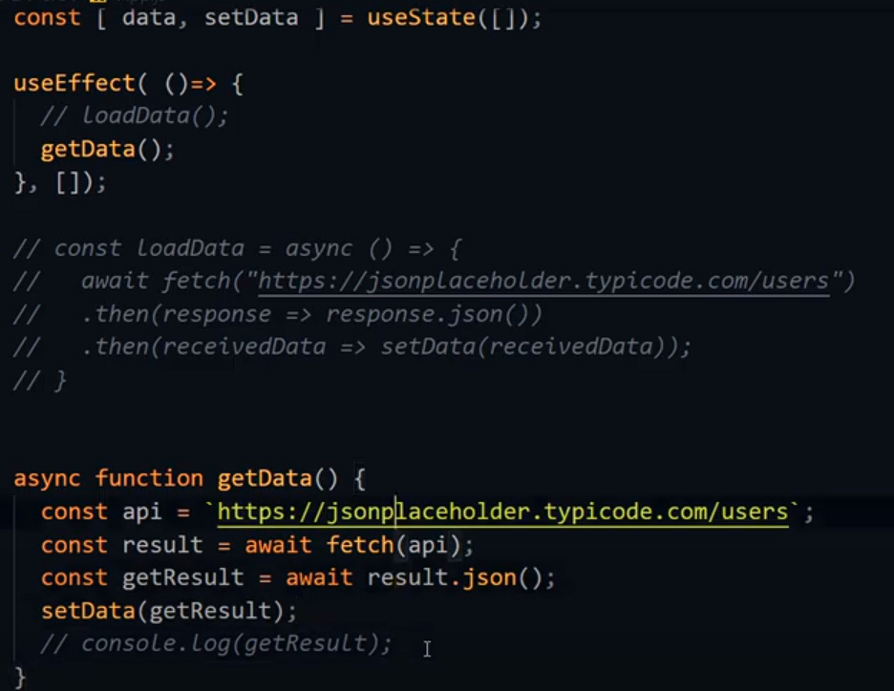
Fetch data

Slide 15
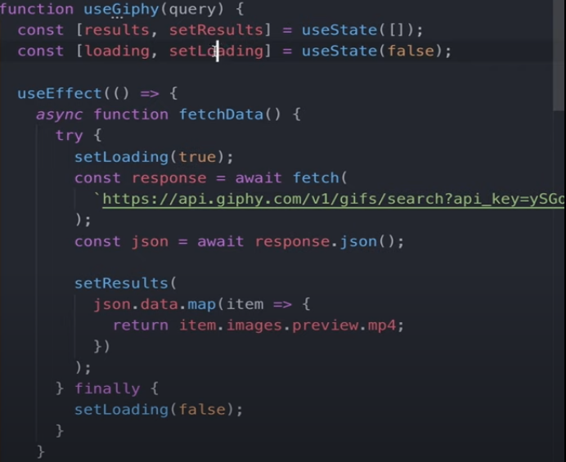
Fetch data

